Slide 1

DBSCAN
Density-Based Spatial Clustering Application with Noise

Slide 2
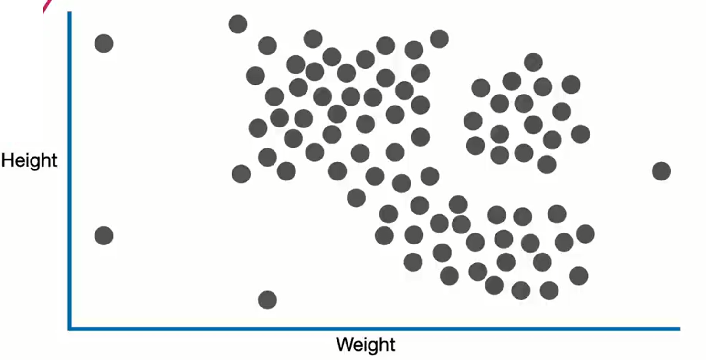

Slide 3
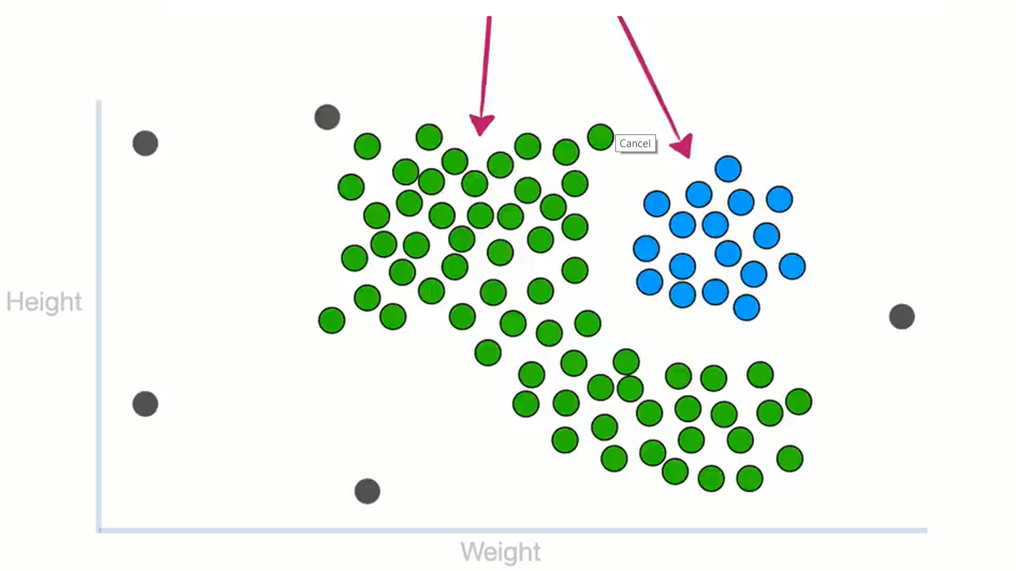

Slide 4
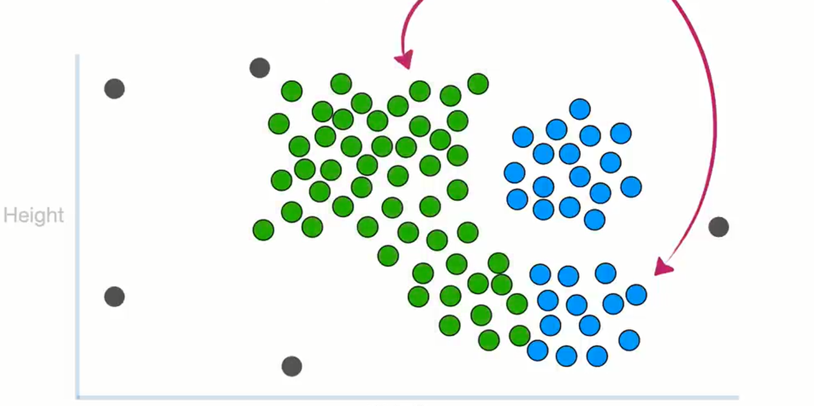

Slide 5
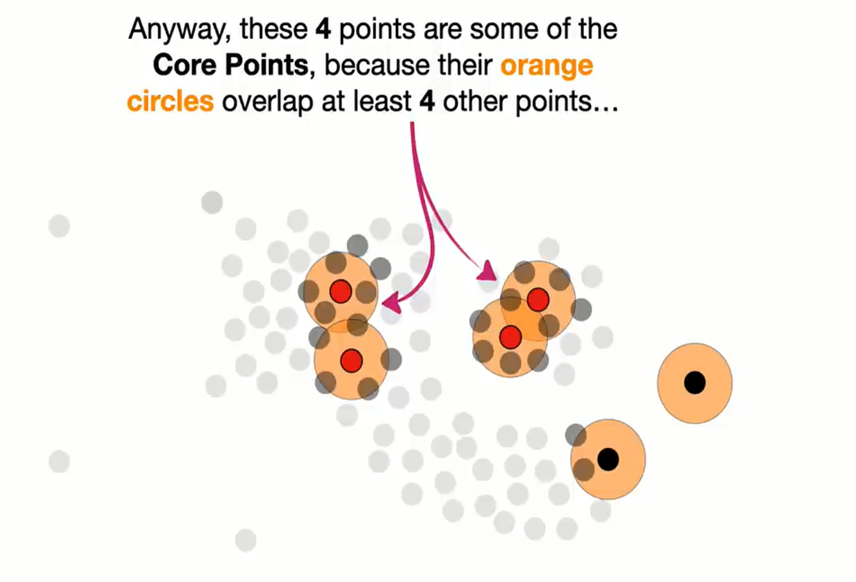

Slide 6
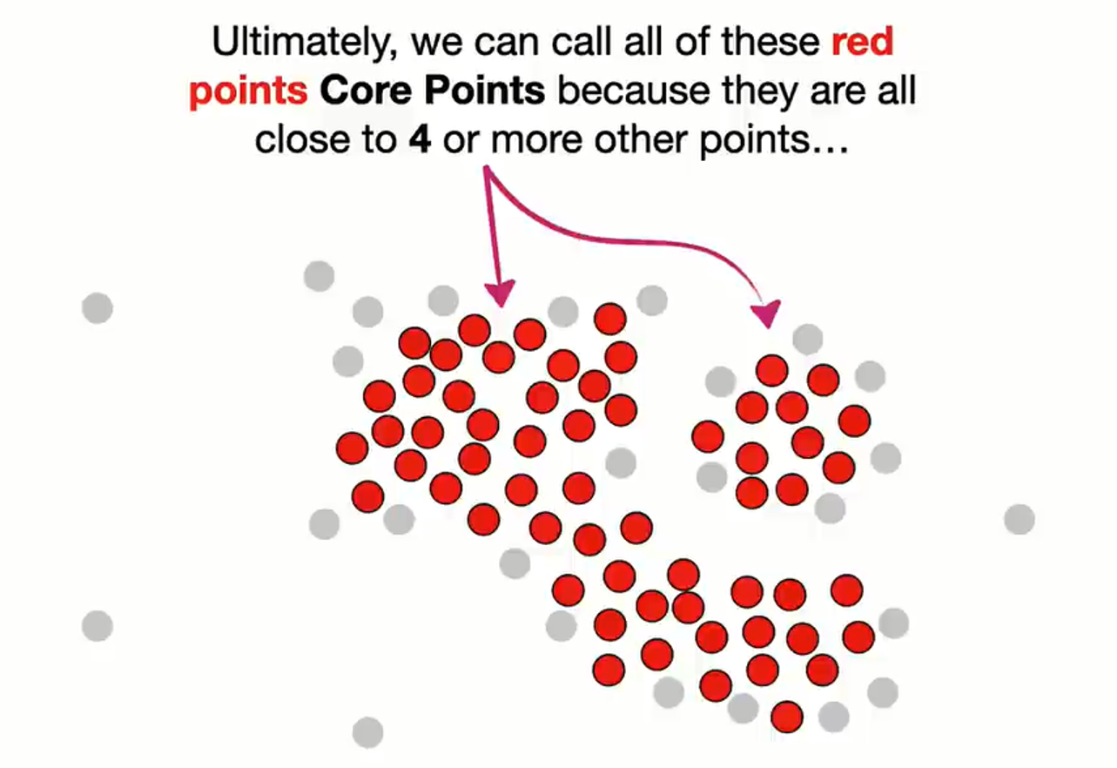

Slide 7
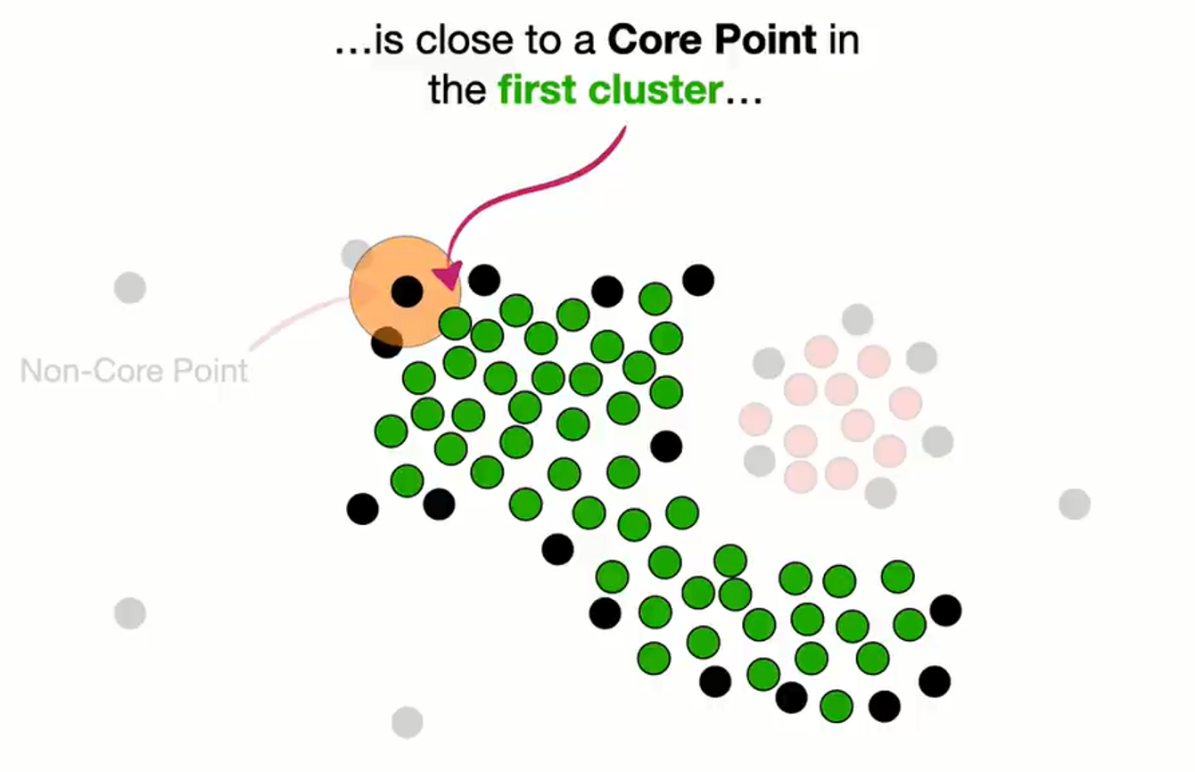

Slide 8
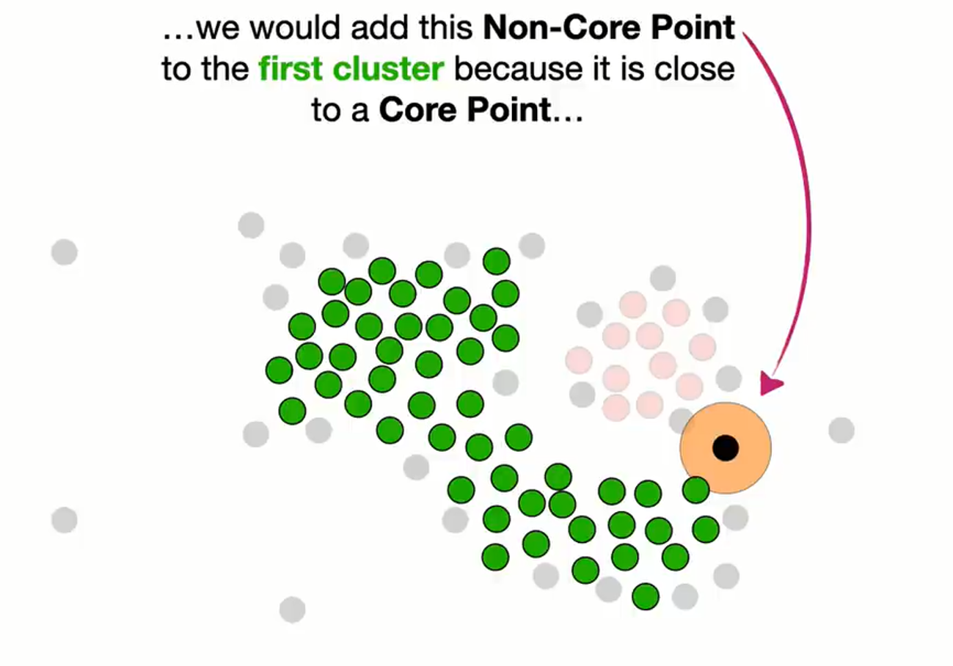

Slide 9
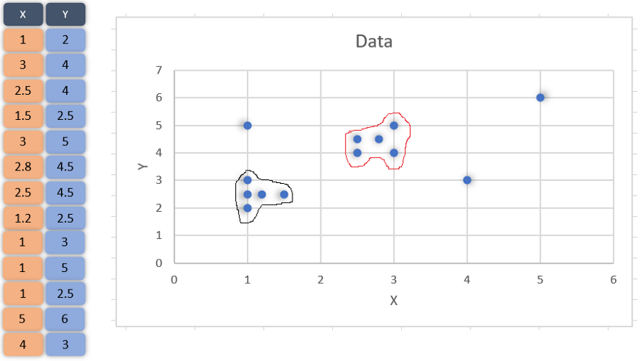

Slide 10
The clustering is made as described through the below steps:
Choose a value for eps and MinPts
For a particular data point (x) calculate its distance from every other datapoint.
Find all the neighbourhood points of x which fall inside the circle of radius (eps) or simply whose distance from x is smaller than or equal to eps.
Treat x as visited and if the number of neighbourhood points around x are greater or equal to MinPts then treat x as a core point and if it is not assigned to any cluster, create a new cluster and assign it to that.
If the number of neighbourhood points around x are less than MinPts and it has a core point in its neighbourhood, treat it as a border point.
Include all the density connected points as a single cluster. (What density connected points mean is described later)
Repeat the above steps for every unvisited point in the data set and find out all core, border and outlier points.

Slide 11
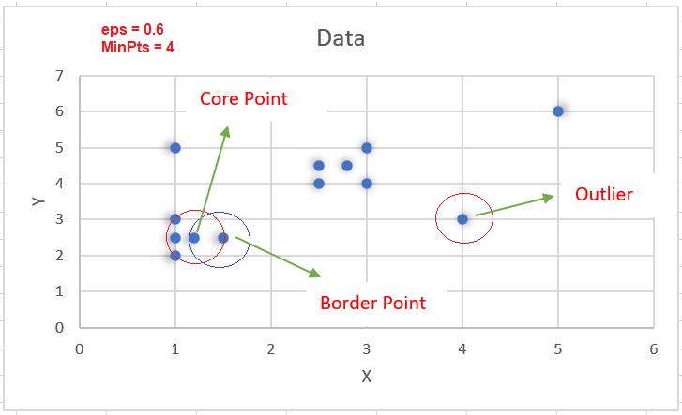
We choose eps = 0.6 and MinPts =4

Slide 12
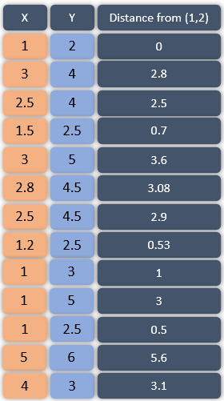
eps = 0.6
MinPts =4

Slide 13
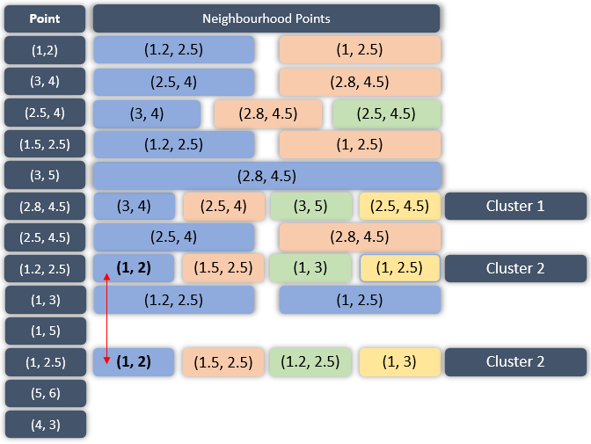
eps = 0.6
MinPts =4

Slide 14
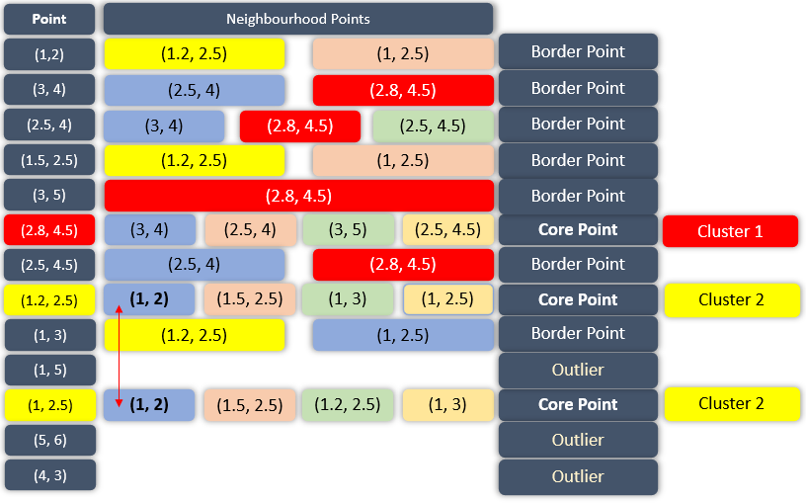
eps = 0.6
MinPts =4

Slide 15
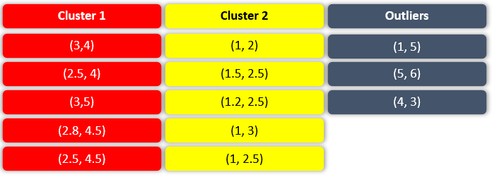

Slide 16
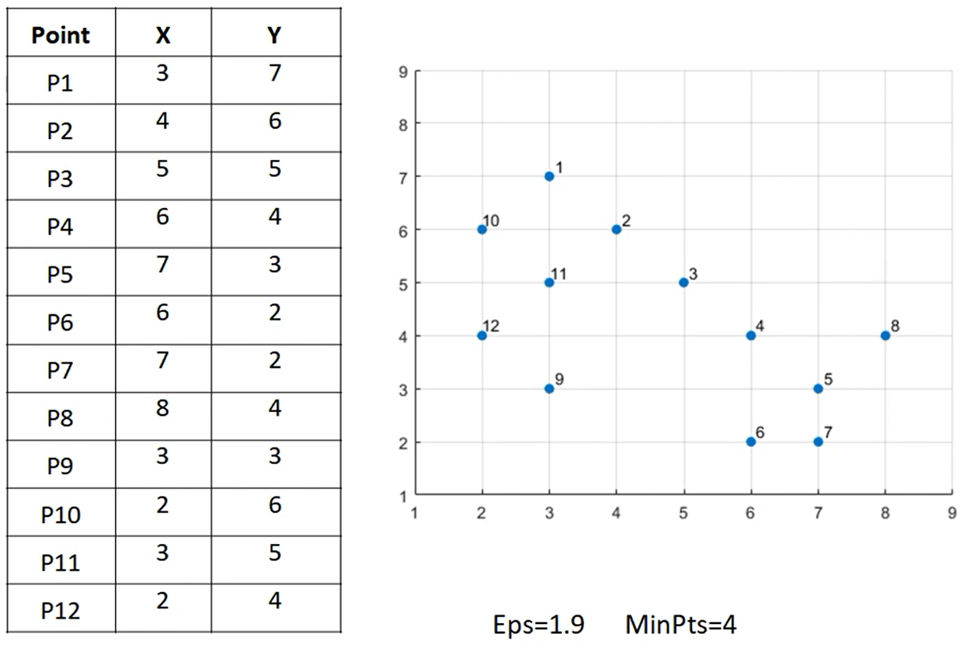

Slide 17
